Slide 1
QA-based Approaches for Text Summarization Evaluation
Yizhu
2021.10.27

Slide 2
Outline
Motivation
Question-Answering based Summarization Evaluation
A Semantic QA-Based Approach for Text Summarization Evaluation
FEQA: A Question Answering Evaluation Framework for Faithfulness Assessment in Abstractive Summarization
Conclusion

Slide 3
Motivation
Automatic Summarization Evaluation
Compare generated summary and reference summary:
BLEU
ROUGE
…
Notes:
I have introduced the summarization evaluation last time.
The traditional summarization evaluation metrics compare generated …, like BLEU and ROUGE
But, because of the variety of abstractive summaries, the evaluation methods comparing reference summary and generated summary always cannot denote the real quality of generated summaries.
The human evaluation can be better, but its cost is too expensive.

Slide 4
Motivation
Source document
Reference Summary
justin timberlake and jessica biel , welcome to parenthood . the celebrity couple announced the arrival of their son , silas randall timberlake , in statements to people . `` silas was the middle name of timberlake 's maternal grandfather bill bomar , who died in 2012 , while randall is the musician 's own middle name , as well as his father 's first , '' people reports . the couple announced the pregnancy in january …… it is the first baby for both .
timberlake and biel welcome son silas randall timberlake . the couple announced the pregnancy in january .
Generated Summary 1
Lower ROUGE
timberlake and biel announced the arrival of their son . it is the first baby for both .
Generated Summary 2
Higher ROUGE
timberlake and biel welcome their son , silas , who died in 2012 . the couple announced the pregnancy in january .
Notes:
In this example, the source document is about a couple. The couple announced the arrival of their first son, silas randall timberlake.
If we use ROUGE score to compare the reference summary and generated summaries in this example,
GS1 will get a lower ROUGE score, and GS2 will get higher ROUGE score, because ROUGE is to calculate the match tokens between reference summary and generated summary.

Slide 5
Motivation
Source document
Reference Summary
justin timberlake and jessica biel , welcome to parenthood . the celebrity couple announced the arrival of their son , silas randall timberlake , in statements to people . `` silas was the middle name of timberlake 's maternal grandfather bill bomar , who died in 2012 , while randall is the musician 's own middle name , as well as his father 's first , '' people reports . the couple announced the pregnancy in january …… it is the first baby for both .
timberlake and biel welcome son silas randall timberlake . the couple announced the pregnancy in january .
Generated Summary 1
High Quality
timberlake and biel announced the arrival of their son . it is the first baby for both .
Generated Summary 2
Low Quality
timberlake and biel welcome their son , silas , who died in 2012 . the couple announced the pregnancy in january .
Notes:
But the real situation is that,
The GS1 is different from reference, but it is consistent with the source document and can be seen as a high quality summary
The GS2 has factual error, the silas randall timberlake is the son of the couple.

Slide 6
Motivation
Automatic Referenceless Evaluation
Compare generated summary and source document
justin timberlake and jessica biel , welcome to parenthood . the celebrity couple announced the arrival of their son , silas randall timberlake , in statements to people . `` silas was the middle name of timberlake 's maternal grandfather bill bomar , who died in 2012 , while randall is the musician 's own middle name , as well as his father 's first , '' people reports . the couple announced the pregnancy in january …… it is the first baby for both .
Generated Summary 1
timberlake and biel announced the arrival of their son . it is the first baby for both .
Generated Summary 2
timberlake and biel welcome their son , silas , who died in 2012 . the couple announced the pregnancy in january .
Notes:
As we know, the human evaluation can get more accurate evaluation results, but it is too slow and its cost is too expensive.
So more people are exploring automatic referenceless evaluation metrics, which compare generated summary and source document.

Slide 7
Motivation
Automatic Referenceless Evaluation
Compare generated summary and source document
QA-based evaluation metric
Question Generation System
Question Answering System
Source Document
Source Document
Question Generation
Question Answering
answer1
Questions
OR
answer2
Summary
Summary
Notes:
An alternative way is QA-based evaluation metrics.
These methods always consists of QG system and QA system.
They first generate questions from source document or summary.
Then they get the answer of these generated questions from source document and summary.
Finally, the compare the difference between the answers from source document and summary.

Slide 8
QA-based Evaluation Metric
A Semantic QA-Based Approach for Text Summarization Evaluation
FEQA: A Question Answering Evaluation Framework for Faithfulness Assessment in Abstractive Summarization
Notes:
The former is published by AAAI 2018, the latter is published by ACL 2020

Slide 9
A Semantic QA-Based Approach for Text Summarization Evaluation
If we treat one text passage as a small knowledge base, can we ask it a large number of questions to identify all content points in it?
Notes:
The main idea is first to generate a large number of questions from the source document to cover its content, and it is reasonable to assume that source document and summary should contain information to answer these questions.

Slide 10
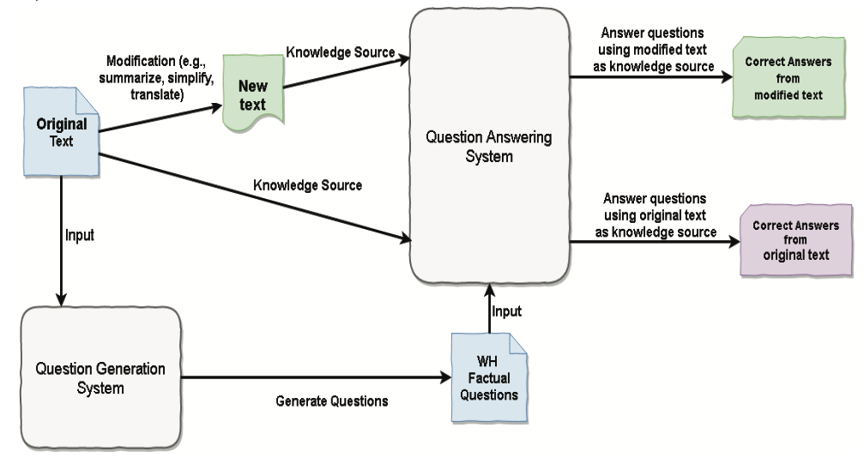
A Semantic QA-Based Approach for Text Summarization Evaluation
Notes:
The main idea is first to generate a large number of questions from an original text passage to exhaustively cover its content, and it is reasonable to assume that the original text contains in- formation to answer these questions.

Slide 11
A Semantic QA-Based Approach for Text Summarization Evaluation
Source Document
...... Born in Hodgenville, Kentucky, Lincoln grew up on the western frontier in Kentucky and Indiana......
Summary
Question Generation System

Slide 12
A Semantic QA-Based Approach for Text Summarization Evaluation
Source Document
...... Born in Hodgenville, Kentucky, Lincoln grew up on the western frontier in Kentucky and Indiana......
Summary
QG step:
factual questions
label the lexical items: named entities or other semantic roles
templates -> perform syntactic transformations: subject-auxiliary inversion and WH-movement
Question Generation System
Notes:
They use an existing QG system to generate some factual questions.
They first analyze the grammatical structure, label the lexical items with name entities or other high-level semantic roles (e.g., person, location, time), and use templates to perform syntactic transformations such as subject-auxiliary/aug’ziliery/ inversion and WH-movement.

Slide 13
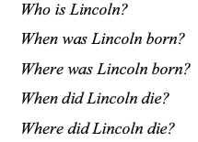
A Semantic QA-Based Approach for Text Summarization Evaluation
Source Document
...... Born in Hodgenville, Kentucky, Lincoln grew up on the western frontier in Kentucky and Indiana......
Summary
Question Answering System
Answers from summary
Answers from original document
Factual Questions
factual questions
named entities
predefined templates
Question Generation System
Notes:
This is an example,
These questions are generated by templates without considering specific text passages,
so it is possible some answers cannot be found in the source document.
But, all questions are still asked to an original text passage and a generated summary
The difference of the two answer sets will show the content difference of two texts.
The effectiveness of this approach depends on the predefined question template.
If the template is carefully constructed, we can obtain questions with good coverage and high quality.
(over-coverage does not matter)
In this paper, they used existing QG and QA system.

Slide 14
A Semantic QA-Based Approach for Text Summarization Evaluation
Source Document
Summary01
Question Answering System
Answers from summary01
Summary02
Answers from summary02
……
……
Summary10
Answers from summary10
Question Generation System
Ranking
Factual Questions
Notes:
To compare the generated summaries by different models, we ask questions generated from QG system to all summary 1 to summary 10.
The content quality of a summary can be measured by the number of questions answered by the QA system, given this summary as the only knowledge.

Slide 15
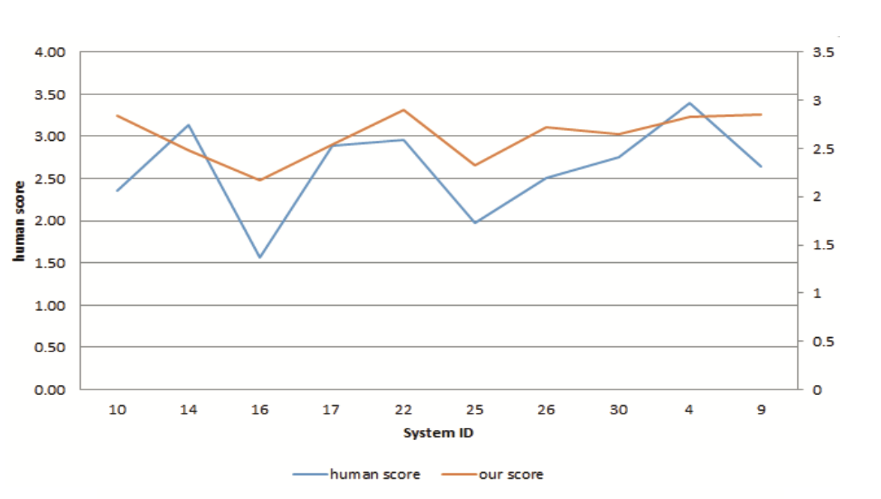
A Semantic QA-Based Approach for Text Summarization Evaluation
Experiment
DUC 2007
4 human assessors
45 source documents, 10 summariers
Metric | Pearson
ROUGE-2 | 0.9281
QA-based Eval | 0.8363
Notes:
To test this system, we use the dataset DUC 2007, which consists of 45 source documents.
They use 10 summarizers to generate summaries and ask 4 human annotators to give scores on the content consistency with source document and linguistic quality of the generated summaries.
The left figure shows the evaluation results of Human and the proposed approach.
The right table shows the Pearson correlation

Slide 16
A Semantic QA-Based Approach for Text Summarization Evaluation
Limitation
generate questions from source document
use templates
Notes:
This is because of the limitation of this approach

Slide 17
A Semantic QA-Based Approach for Text Summarization Evaluation
Original Document
...... Born in Hodgenville, Kentucky, Lincoln grew up on the western frontier in Kentucky and Indiana......
Summary
Question Answering System
Answers from summary
Answers from original document
Factual Questions
factual questions
named entities
predefined templates
Question Generation System
Notes:
They generate questions from source document by template
summary may not contain all of the information of source document.
The longer summary may get better score.
QA-based evaluation metric by generating questions from source document are suitable for evaluating whether important information in the source is recovered from the summary.
It ignore the Inconsistent information between summary and source document

Slide 18
A Semantic QA-Based Approach for Text Summarization Evaluation
justin timberlake and jessica biel , welcome to parenthood . the celebrity couple announced the arrival of their son , silas randall timberlake , in statements to people . `` silas was the middle name of timberlake 's maternal grandfather bill bomar , who died in 2012 , while randall is the musician 's own middle name , as well as his father 's first , '' people reports . the couple announced the pregnancy in january …… it is the first baby for both .
Generated Summary 2
timberlake and biel welcome their son , silas , who died in 2012 . the couple announced the pregnancy in january .
Notes:
In this example, the content about silas is unfaithful to source document.
the key challenge to faithfulness evaluation is to verify highly abstractive sentences against the source document, where surface similarity matching would fail.

Slide 19
FEQA: A Question Answering Evaluation Framework for Faithfulness Assessment in Abstractive Summarization
justin timberlake and jessica biel , welcome to parenthood . the celebrity couple announced the arrival of their son , silas randall timberlake , in statements to people . `` silas was the middle name of timberlake 's maternal grandfather bill bomar , who died in 2012 , while randall is the musician 's own middle name , as well as his father 's first , '' people reports . the couple announced the pregnancy in january …… it is the first baby for both .
Generated Summary 2
timberlake and biel welcome their son , silas , who died in 2012 . the couple announced the pregnancy in january .
Generate Questions
Notes:
automatically generated QA pairs to represent information in the summary and validate it against the source.

Slide 20
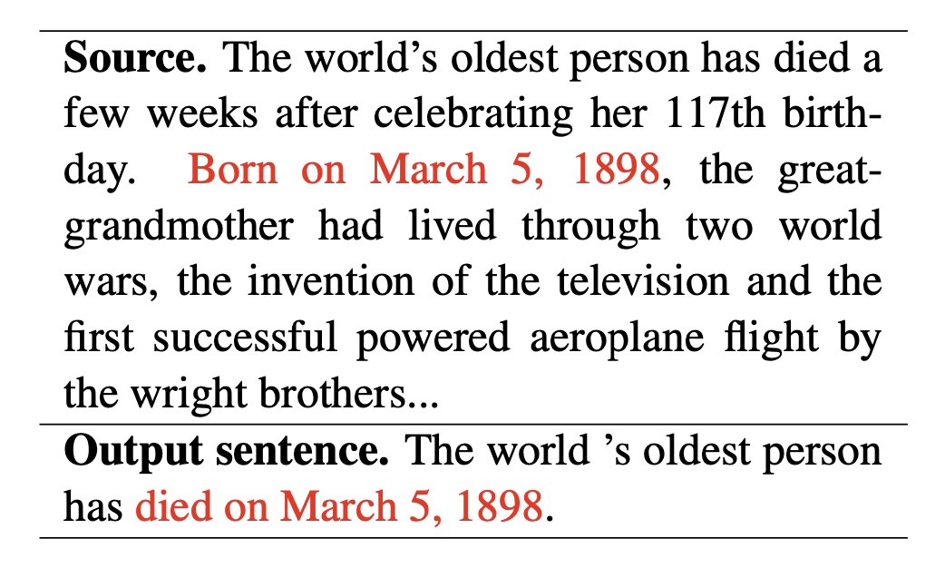
FEQA: A Question Answering Evaluation Framework for Faithfulness Assessment in Abstractive Summarization
Notes:
Table 1 shows an example of unfaithful generation.
Inspired by prior work, we use automatically generated QA pairs to represent information in the summary and validate it against the source.

Slide 21
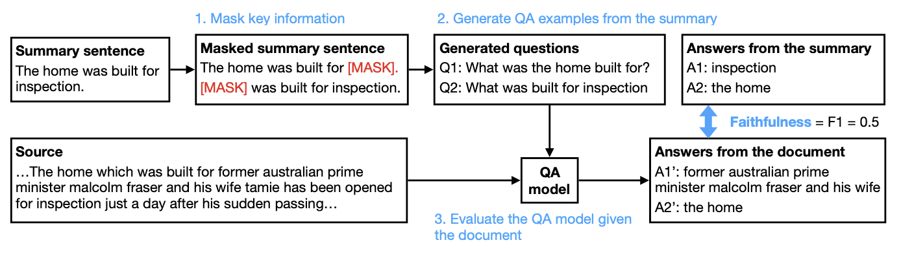
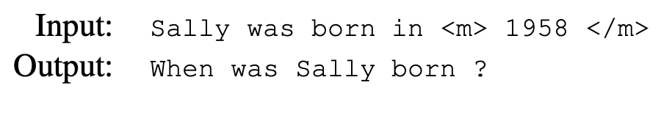
FEQA: A Question Answering Evaluation Framework for Faithfulness Assessment in Abstractive Summarization
Model: BART
Data: QA2D
Notes:
Given a summary sentence, we produce a list of questions asking about key information in the sentence and their corresponding answers.
we mask important text spans in a sentence, including noun phrases and named entities.
each span as the gold answer and generate its corresponding question by fine-tuning a pretrained BART language model
noun phrases extracted by a constituency parser and named entities extracted by the Stanford CoreNLP NER model.

Slide 22
FEQA: A Question Answering Evaluation Framework for Faithfulness Assessment in Abstractive Summarization
Notes:
Given the QA pairs generated from a summary sentence, we run off-the- shelf QA models to get answers to these questions from the source document.

Slide 23
FEQA: A Question Answering Evaluation Framework for Faithfulness Assessment in Abstractive Summarization
Model: BERT-base
Data: SQuAD-1.1 and SQuAD 2.0
Notes:
We experiment with the pretrained BERT-base model and fine-tuned on SQuAD-1.1 and SQuAD-2.0.
Note that in the case of SQuAD-2.0, the model may be able to hypothesize that a question is unanswerable. This case is equivalent to getting an answer incorrect (i.e. unfaithful).

Slide 24
FEQA: A Question Answering Evaluation Framework for Faithfulness Assessment in Abstractive Summarization
gold
Model: BERT-base
Data: SQuAD-1.1 and SQuAD 2.0
Notes:
We then measure the average F1 score against the “gold” answers from the summary, which is our faithfulness score for the given sentence.
If a question is unanswerable. This case is equivalent to getting an answer incorrect

Slide 25
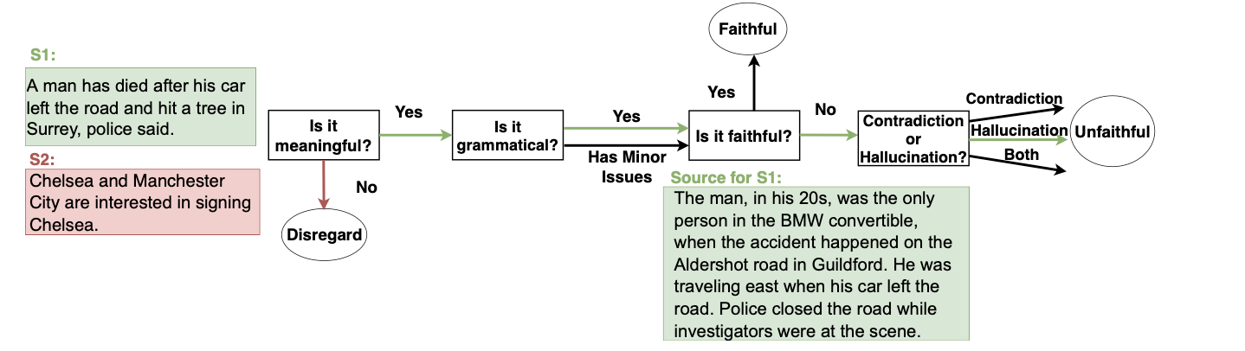
FEQA: A Question Answering Evaluation Framework for Faithfulness Assessment in Abstractive Summarization
Experiment
CNN/DM (748) and XSUM (286)
5 annotators
Notes:
human annotation process. Decision nodes are rectangular and outcome nodes are circular. We show the annotation path of two summary sentences, S1 (green arrows) and S2 (red ar- rows). S2 is annotated as nonsensical thus is not considered for faithfulness. S1 is annotated as unfaithful due to hallucinated content.

Slide 26
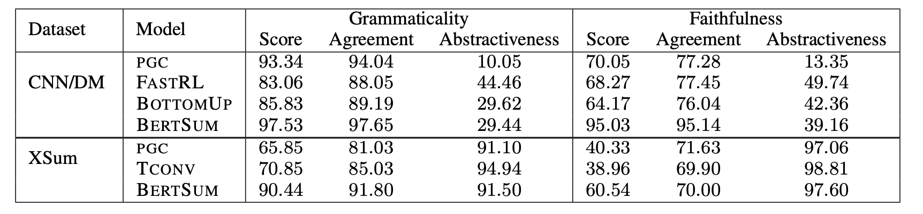
FEQA: A Question Answering Evaluation Framework for Faithfulness Assessment in Abstractive Summarization
Experiment
CNN/DM (748) and XSUM (286)
5 annotators
Notes:
faithfulness results of human annotations.
The faithfulness Score of one generated summary is the percentage of annotators that think this summary faithful,
The faithfulness score of a model is the average of these values across all the generated summaries frome this model.
Agreement is computed by taking the percentage of the workers that annotate the majority class for the given example.
Abstractiveness is measured by the percentage of novel trigrams in a given sentence.
We con- sider a sentence meaningful if at least 4 out of 5 annotators label it as meaningful in the first stage.

Slide 27
FEQA: A Question Answering Evaluation Framework for Faithfulness Assessment in Abstractive Summarization
Experiment
CNN/DM (748) and XSUM (286)
5 annotators
Metric | CNN/DM |  | XSUM
 | Pearson | Spearman | Pearson | Spearman
ROUGE-1 | 12.02 | 15.86 | -2.57 | 0.07
ROUGE-2 | 13.25 | 15.99 | -5.78 | -8.47
ROUGE-L | 12.58 | 16.49 | -6.37 | -9.68
FEQA | 32.01 | 28.23 | 26.31 | 21.34
Notes:
XSUM is more abstractive

Slide 28
FEQA: A Question Answering Evaluation Framework for Faithfulness Assessment in Abstractive Summarization
Limitation
noise from QA system
Majority of the errors of the QA system are because it either didn’t detect unanswerable questions or produces “unanswerable” when there exists an answer (14%)
use ROUGE to compare gold answer and generated answer
“Donald Trump” vs. “the President of the United States Donald Trump”
Notes:
Grammaticality and faithfulness results of human annotations. Score is computed by taking the percentage of annotators that selected “meaningful” and “faithful” for grammaticality and faithfulness annotation tasks, respectively, and then averaging these values across all the examples for the given annotation task.
Agreement is computed by taking the percentage of the workers that annotate the majority class for the given example.
Abstractiveness is measured by the percentage of novel trigrams in a given sentence.
We con- sider a sentence meaningful if at least 4 out of 5 annotators label it as meaningful in the first stage.

Slide 29
Conclusion
QA-based metrics are more suitable for fact checking.
The results can be evaluated from different perspectives.
We can use other tasks to improve the evaluation metrics.

